Slide 1
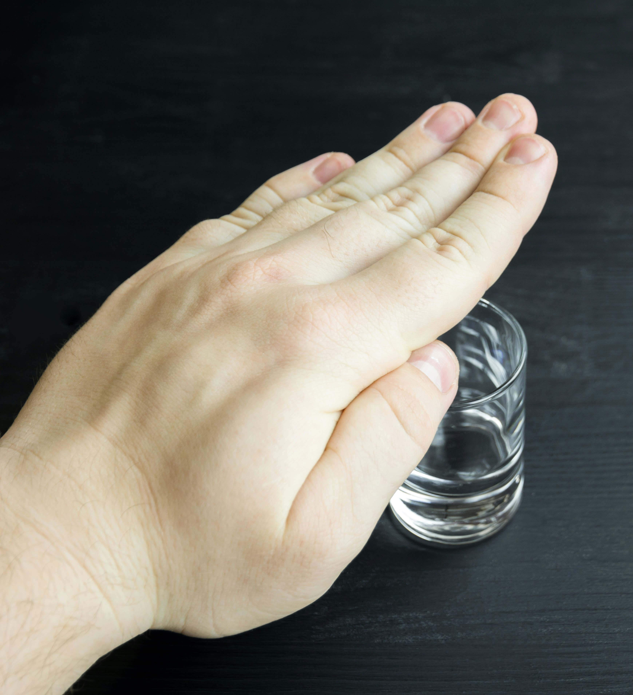
The Cost-Effectiveness of Social and Behavior Change Campaigns (SBCC)
and Cessation Services in Reducing
Alcohol-Related Harms in the Philippines
ANDREA MARGRETH S. ORA-CORACHEA, MDE, MPH, RN
Health Promotion Bureau
Department of Health - Philippines

Slide 2

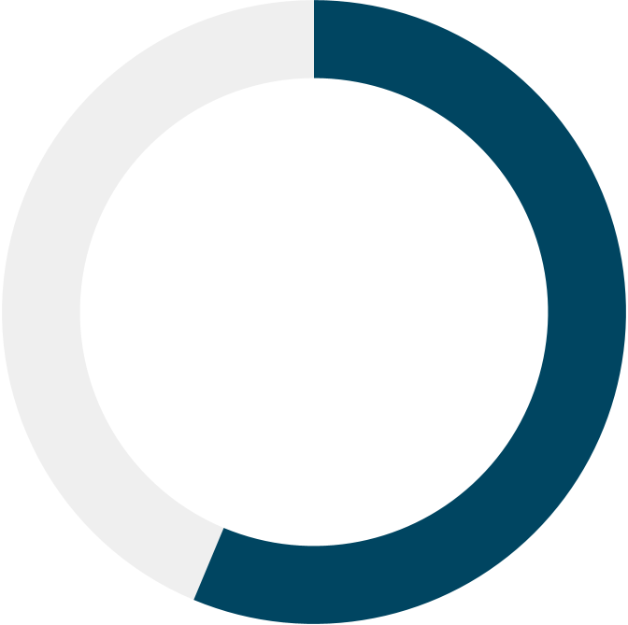
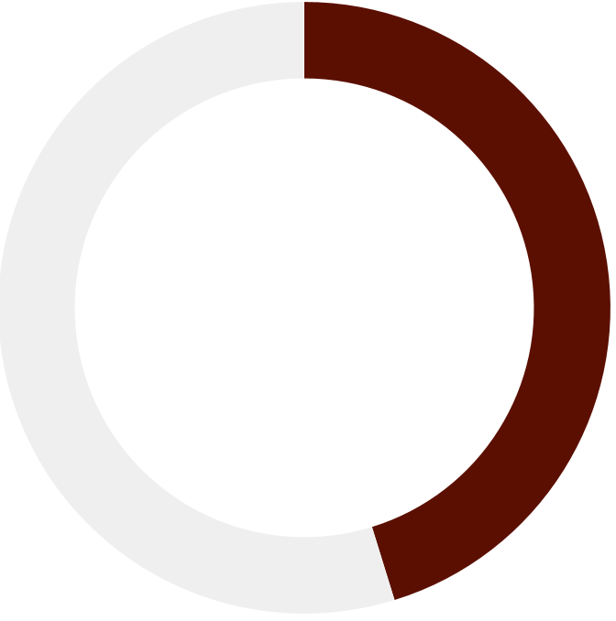
Every 20 MINUTES,
a Filipino dies from alcohol-attributable causes, including cancers, liver diseases, and cardiovascular diseases.
56.3%
36.1%
Filipino adults consume alcohol
Filipino adults unaware of the health harms of alcohol consumption

Slide 3
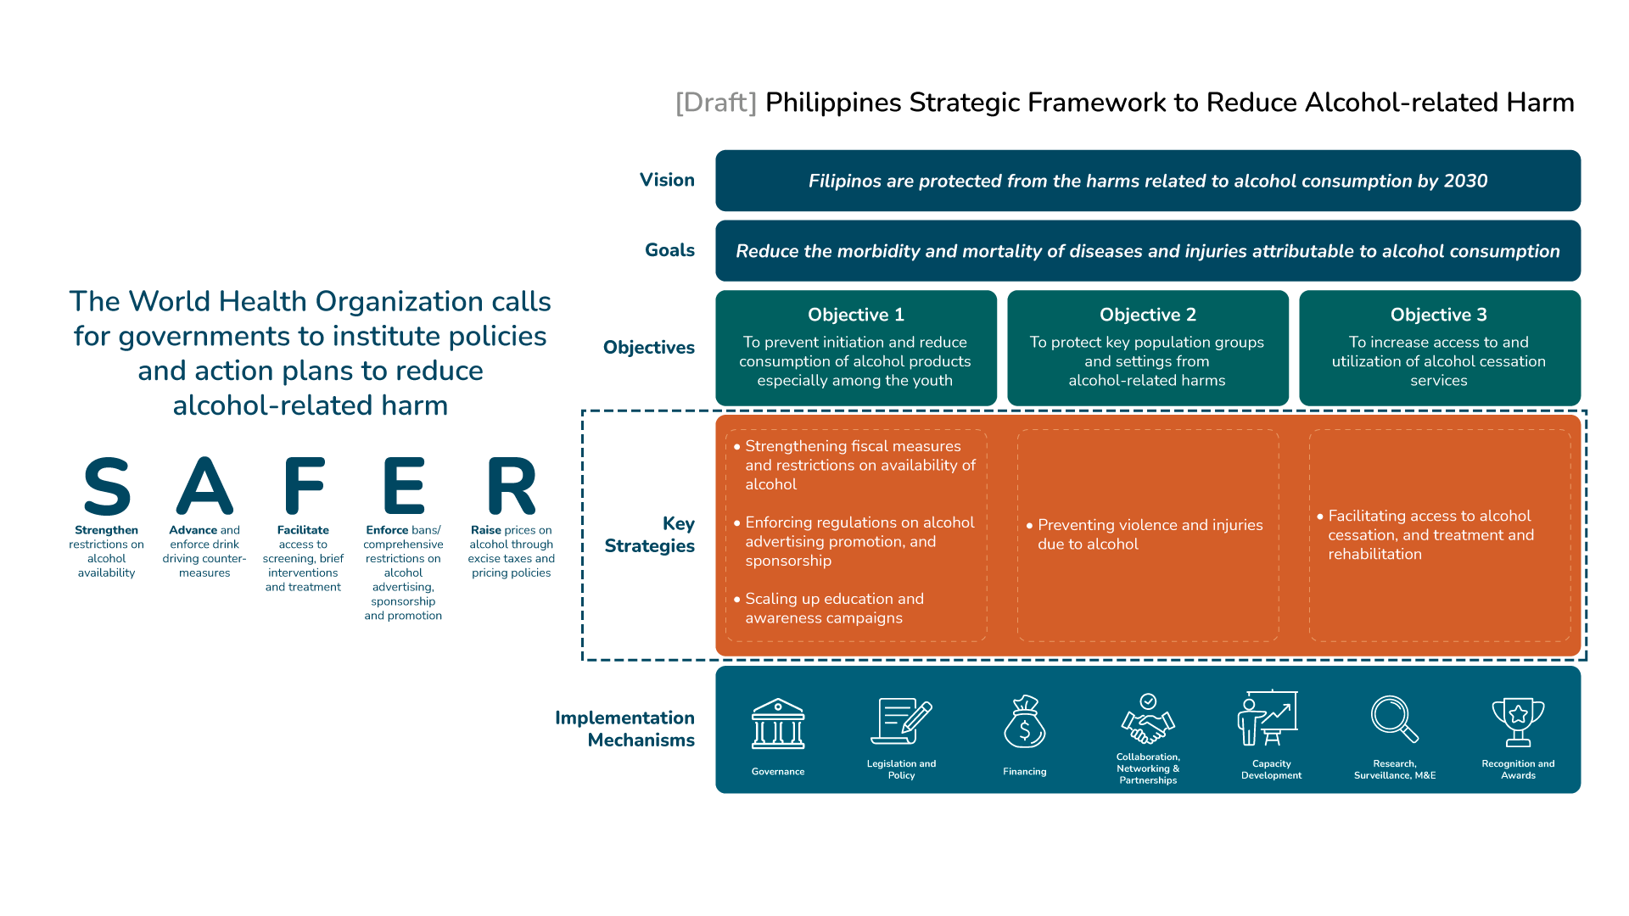

Slide 4
Facilitating access to alcohol cessation, and treatment and rehabilitation
Scaling up education and awareness campaigns

Slide 5




Research Question:
Is it cost-effective to implement social and behavior change campaigns (SBCC) and alcohol cessation services to avert alcohol-related harm?
Department of Health Perspective
Lifetime Analytic Horizon
Filipino 20y.o. and above
3.66%
discount rate
Data Sources:
• GBD, Country Surveys (Prevalence of Alcohol Consumption, Health Literacy Survey), Discount Rate and WTP threshold from Philippines-HTA Unit, Administrative Data on the Cost of Implementing the Interventions, Literature on the Effectiveness of SBC and Cessation Services

Slide 6



Policy Options
Policy Option 1 (Baseline): Ad hoc education campaign as part of major celebrations/holidays
Policy Option 2
Policy Option 3
Policy Option 4
Social and Behavior Change Campaigns (Above-the line and
Below-the-line)
Alcohol Cessation Program
(delivered through key settings: communities, schools, workplaces)
Combination of
Policy Options 2&3
(SBCC +
Alcohol Cessation Program)

Slide 7
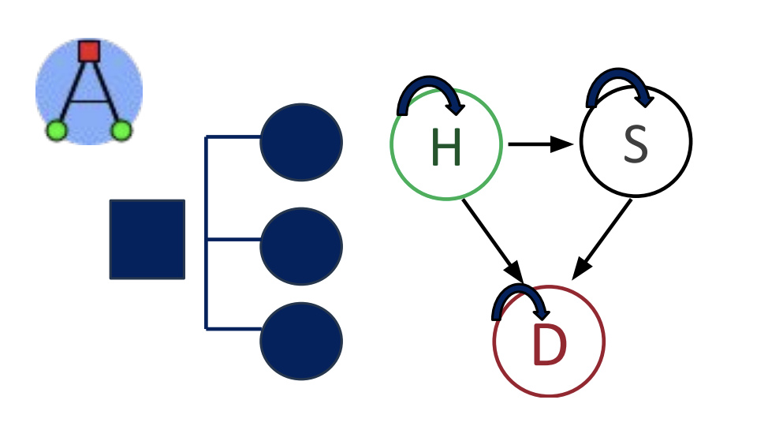
Methodology
?
Public Health Impact
?
Operational Feasibility
?
Political Feasibility
Decision Tree + Markov Model
using the AMUA software
?
Budget Impact
Policy Analysis
(CDC’s Policy Analytical Framework)
Cost-Effectiveness Analysis
(USD/DALY averted)

Slide 8
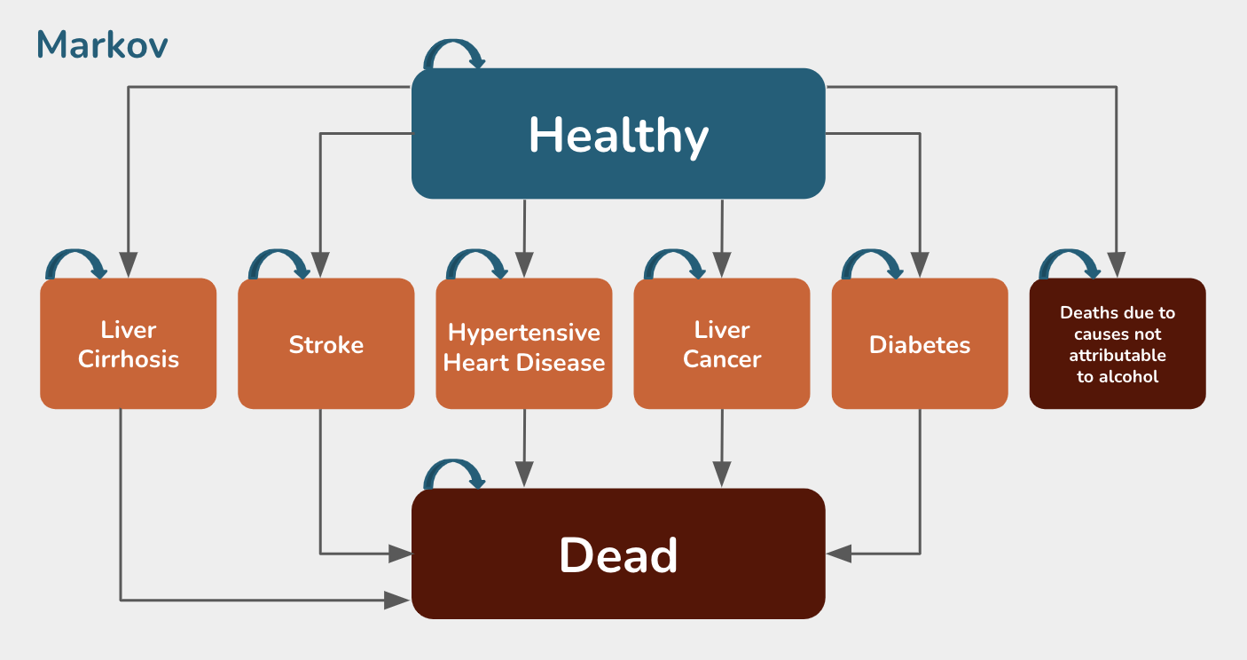
Cost-Effectiveness Analysis: Model Structure
Analytical Horizon: Lifetime Cycle: 1 year
Discounting rate: 3.66% (based on Philippine HTA guide)
Markov
Drink
M
Healthy
Status quo
Not Drink
M
Liver Cirrhosis
Stroke
Hypertensive Heart Disease
Liver Cancer
Diabetes
Deaths due to causes not attributable to alcohol
Drink
M
SBCC
Filipinos aged 20 years and older
Not Drink
M
Dead
Drink
M
Cessation
Main Assumptions:
Alcohol users will only suffer from one disease in their lifetime
The risk of transitioning to alcohol-attributable diseases remain constant over time
Transitioning from Healthy to Sick, and Sick to Death states are irreversible
Not Drink
M
SBCC + Cessation
Drink
M
Not Drink
M
* Model only included the top five alcohol-attributable deaths

Slide 9




Policy Analysis
Strategy |  | Public Health Impact | Operational Feasibility | Political Feasibility | Budget Impact*
 | Policy Option 1 Educational campaign as part of major celebration | Low | High | High | Low (no significant resource requirement)
 | Policy Option 2 Social and Behavior Change Campaigns (SBCC) | High | High | High | Medium ($2.57M annual implementation cost)
 | Policy Option 3 Alcohol Cessation Program | High | High | High | Medium ($25.14M annual implementation cost)**
 | Policy Option 4 Combination of SBCC and Cessation Program | High | High | High | Medium ($18.88M annual implementation cost)**
*Budget impact assessment considered whether implementation costs could be covered by existing program funds or required additional funding ** Cost requirement includes fixed cost for program implementation and variable cost for individual counselling (different between drinkers and non-drinkers)

Slide 10
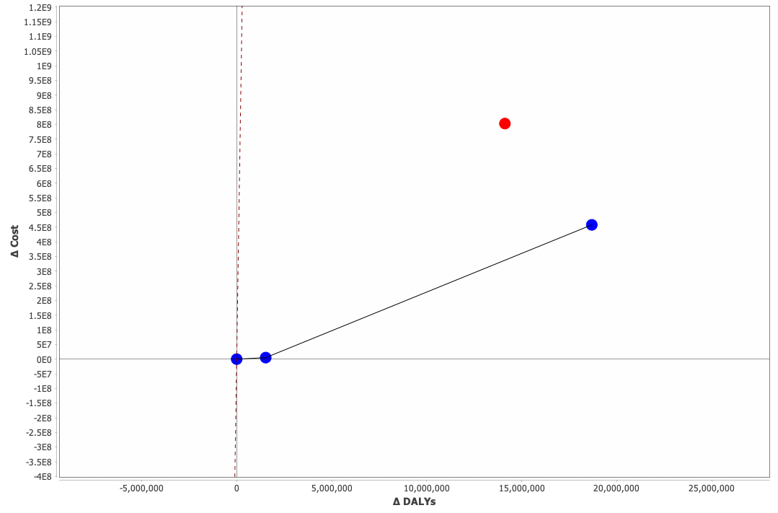
Policy Option 4, which combines SBCC and cessation services,
Resulted in the highest ICER that is within the Willingness-to-Pay threshold*
Policy Option | ICER (WTP: USD 4, 183.52)*
1 | -
2 | USD 3.37 / DALY averted
4 | USD 26.38 / DALY averted
3 | Strongly dominated
Policy Option 3:
Alcohol cessation program
Policy Option 4:
SBCC and cessation program
Policy Option 1:
Baseline scenario
Policy Option 2:
SBCC
*Willingness-to-Pay threshold: USD 4,183.52 derived from the Philippine HTA methods guide of using 1x GDP/capita per DALY averted

Slide 11
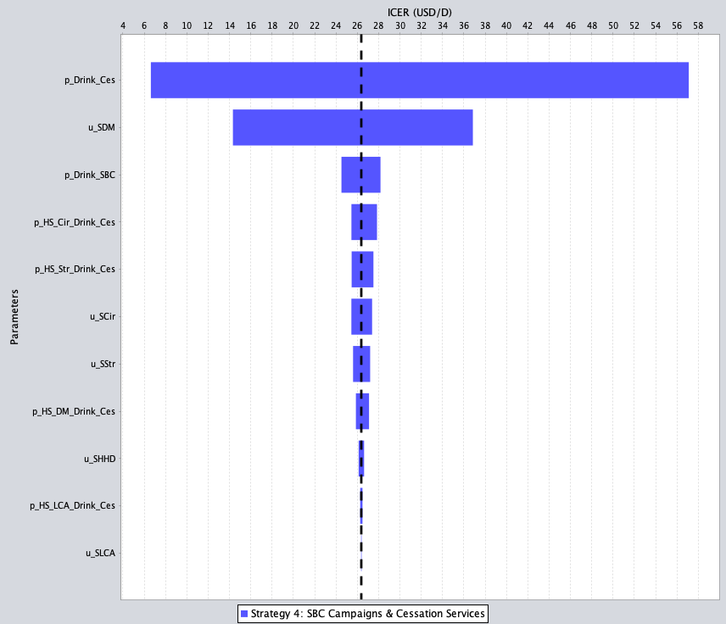
Sensitivity Analysis
Drinking among individuals in cessation program
Findings remained robust across a range of sensitivity scenarios
Severity of diabetes mellitus (disability weight)
Drinking among individuals reached by the SBCC
Most sensitive parameters:
Probability of consuming alcohol among individuals who availed of the cessation service
Severity of disease (disability weight for diabetes mellitus)
Probability of consuming alcohol among individuals reached by the SBCC
Prob. of cirrhosis among drinkers who availed of cessation service
Prob. of stroke among drinkers who availed of cessation service
Severity of liver cirrhosis (disability weight)
Severity of stroke
(disability weight)
Prob. of DM among drinkers who availed of cessation service
Severity of hypertensive heart disease (disability weight)

Slide 12

Implementing social and behavior change campaigns alongside cessation services is a cost-efficient
strategy for reducing alcohol-related harms.

Slide 13







Thank you!
Special thanks to:
ANDREA MARGRETH S. ORA-CORACHEA, MDE, MPH, RN
Chief for Policy, Planning, Standards and Research
Health Promotion Bureau
Department of Health - Philippines
For questions or clarifications:
acorachea@doh.gov.ph
corachea.andrea@gmail.com
+63 977 853 9871
www.doh.gov.ph

