Slide 1

Cost-Effectiveness of Latent Tuberculosis Infection Screening and Treatment Modalities in Zambia
Authors: Lawrence Mwenge, Buumba Tapisha, Ab Schaap, Richard Mwape, Kwame, Shanaube, Helen Ayles

Slide 2
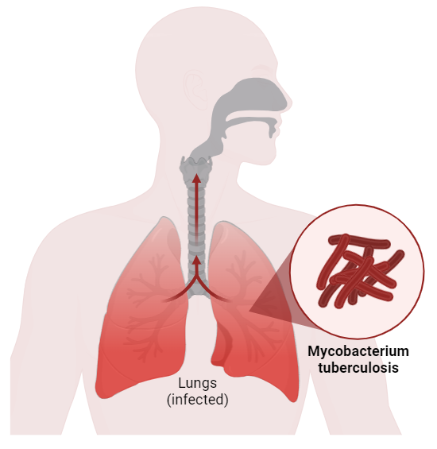
Background: Disease overview
Globally, One quarter of the population is infected with TB
Zambia is among the top 30 countries worldwide with high TB burden
Individuals with TB infection (TBI) have ~10% risk of developing TB disease
Progression of TB infection to TB disease can be prevented with TB preventive therapy (TPT)

Slide 3
Background: Study rationale
Current policy: TB symptom screening plus 6-month isoniazid (6H):
New treatment regimes have been introduced: 3 months of weekly isoniazid and rifapentine (3HP) & 30 days of isoniazid and rifapentine (1HP)
Current TBI Detection Methods may not be suitable for Zambia
New TBI tests have been added as alternatives - Cy-TB skin & TB Feron FIA tests
Policy is under review to include new recommendation
“These findings are timely as we are in a process of amending TPT policy… I was particularly fascinated by the costing findings, and we look forward to the presentation of these findings during a technical working group” MOH representative at the National dissemination of the trial results

Slide 4
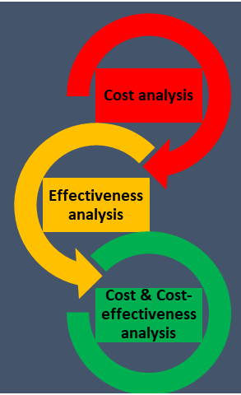
Study Overview
Policy Question: Should Zambia adopt a targeted testing approach for latent tuberculosis infection (TBI) among high-risk groups to optimize the effectiveness and cost-efficiency of Tuberculosis Preventive Therapy (TPT)?
Can targeted TBI testing present value-for-money for TB control in Zambia?
Population: TB HH contacts
Model type: Markov Model
Outcomes: DALYs averted, incremental costs and ICER (cost/DALY averted)
Top Data Sources: TB REACH Trial, Ministry of Health information system and published literature

Slide 5
Strategies to Compare
Household contact of TB
Standard of care
Cy-TB skin test
TB-Feron test
Offered Cy-TB test
Offered TB-Feron test
Accept Cy-TB
Accepts TB-Feron test
Offered TPT
Cy-TB read
TB-Feron test results
Cy-TB +
Cy-TB -
TB-Feron +
TB-Feron -
Start TPT
No TPT
Start TPT
No TPT
Start TPT
No TPT
Main comparator: ‘Do nothing

Slide 6
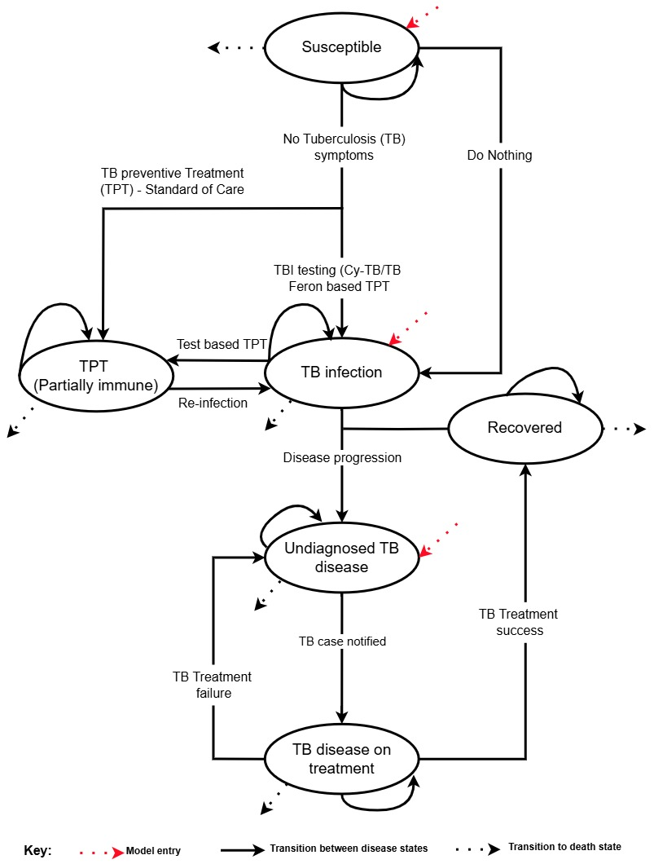
Model Structure
Cohort size: 1 HH contact
Closed cohort
Time horizon: 50 year
Cycle length: 1 month
One-month TPT regimen
Cohort member can enter at susceptible, TB infection or undiagnosed active TB state

Slide 7
Results: Incremental Cost-effectiveness
Strategy | DALY | Cost (US$) | DALYs averted | Increm. Costs (us$) | ICER | Notes
Do Nothing | 212.17 | 729.70 | --- | --- | --- | Baseline
Standard of Care | 191.22 | 832.55 | --- | --- | --- | Weakly Dominated
CyTB based TPT | 87.95 | 996.31 | 124.22 | 266.61 | 2.15 | ---
TB Feron FIA based TPT | 87.58 | 1008.85 | 0.37 | 12.54 | 33.94 | ---
Both TBI test based TPT are more effective than Standard of Care
CyTB based TPT has an ICER of US$2.15 per DALY averted
TB Feron FIA based TPT has an ICER of US$33.94 per DALY averted

Slide 8
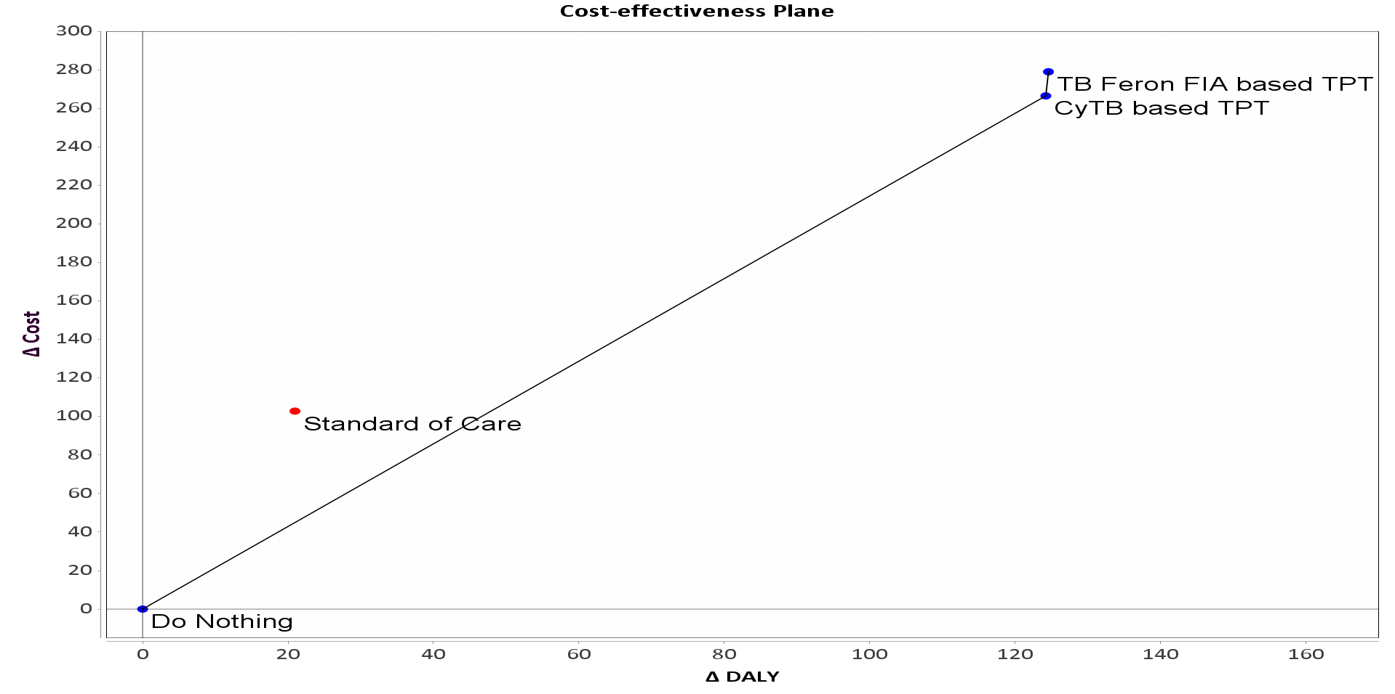
Discussion
CyTB based TPT - most cost-effective option
Although more effective, TB Feron FIA based TPT has a higher ICER
Price of TB Feron FIA not yet know
Standard of Care was weakly dominated
It may not be the best use of resources

Slide 9
Policy implication
CyTB-based TPT strategy may be considered for LTBI treatment in Zambia
Further research may be needed to determine the feasibility and scalability of these interventions.

Slide 10





Thank you
This research and conference presentation were supported by Vital Strategies and the CDC Foundation, partners in the Bloomberg Philanthropies Data for Health Initiative, and Vanderbilt University Medical Center

